Slide 1
AllLife Bank Credit card customer base - Segments
Business Presentation

Slide 2
Contents
Business Problem Overview
Data Overview
Exploratory Data Analysis (EDA)
Clustering Performance Summary
Business Insights and Recommendations

Slide 3
Business Problem Overview and Solution Approach
AllLife Bank wants to focus on its credit card customer base in the next financial year. So, they are
interested in improving the penetration in the market.
The bank plans to run personalised campaigns to target new customers as well as upsell to existing customers.
The banks operations team wants to upgrade the service delivery model to ensure that customers queries are resolved faster.
So, the Data Science team will help to address above targets by identifying different segments in the existing customer based on their spending patterns as well as past interaction with the bank.
As a Data Scientist, We’ll build different clustering methods and find appropriate methods to find the insights on the customer credit card base details.

Slide 4
Data Overview
The data contains information about 660 customers and their characteristics
The characteristics includes,
Customer Key
Average credit limit
Total credit cards
Total visit to bank
Total visit online
Total calls made
There is no missing values in the given customer credit card base details.

Slide 5
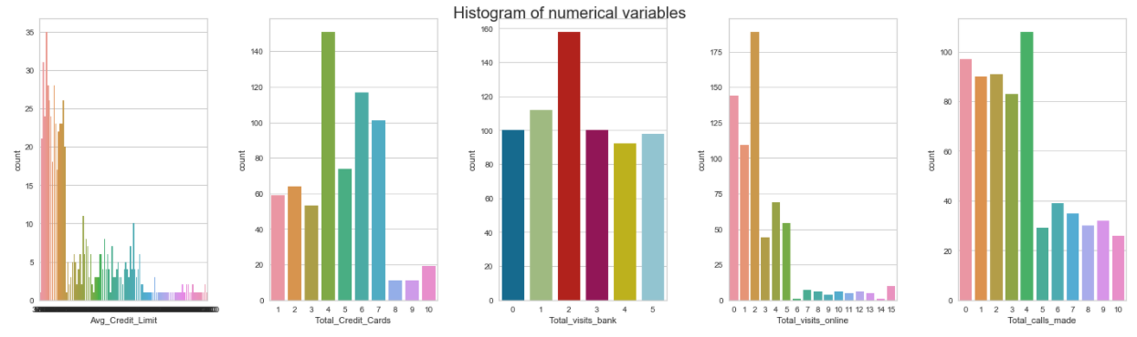
Exploratory Data Analysis
Features | Minimum | Maximum
Average Credit limit | 3000 | 200000
Total Credit cards | 1 | 10
Total visits bank | 0 | 5
Total visits online | 0 | 15
Total Calls made | 0 | 10

Slide 6
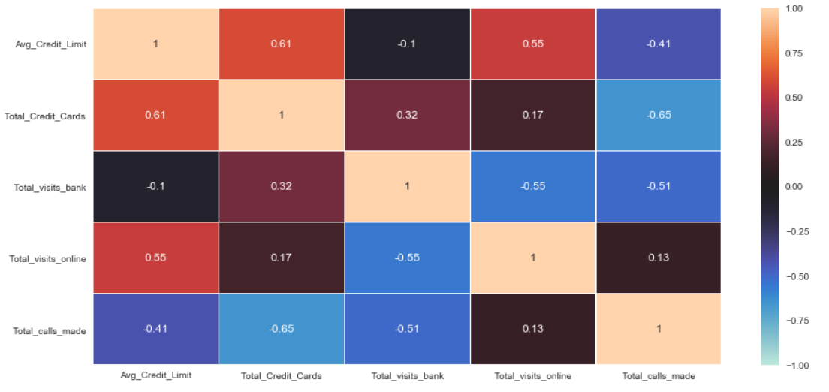
Exploratory Data Analysis
Feature1 | Feature2 | Correlation
Total credit card | Average credit limit | +
Average credit limit | Total visits online | +
Total credit card | Total visit banks | +
Average credit limit | Total calls made | -
Total credit cards | Total calls made | -
Total visits bank | Total calls made | -
Total visits online | Total visits bank | -

Slide 7
Cluster - steps
K-Means Clustering
Scaling the data set before clustering
Create dataframe from the scaled data above
Select K from Elbow method
Silhouette score
Find optimal no. of clusters with silhouette coefficients
cluster_profile
Hierarchical Clustering
Scaling the data set before clustering
Create dataframe from the scaled data above
Cophenet index - measure of the correlation
Explore different linkage_methods
compare Cophenetic Coefficient for each linkage
Find appropriate number of cluster from dendrogram
cluster_profile

Slide 8
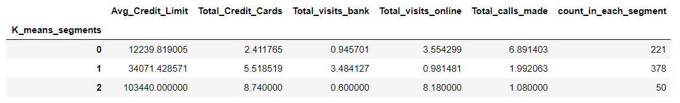
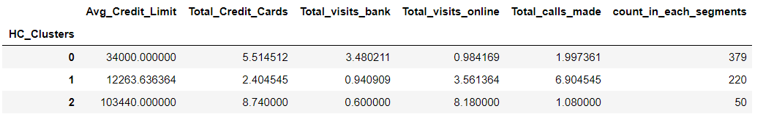
Clusters - Comparisons
K-means clusters
Hierarchical clusters

Slide 9
Business Insights and Recommendations
Cluster 0: 58% of the total customers.
The customer profile has good Avg.credit limit, number of credit cards and has total visits bank is very much higher.
These customers makes less online visits and makes very less calls.
Recommendation - Banks can consider this customer profile as moderate income profile with good credit limits,good number of cards and visits bank frequently for any transactions and queries
Banks can target these customers to apply for better Credit limits, apply credit cards.
Banks can target to meet such customers in person in bank to sell some products like insurance, policy.etc..
Banks can encourage them to use online facility and customer care instead of visiting banks for small queries or transactions
Cluster 1: 34% of the total customers
The customer profile makes more number of calls and has very less credit limits, less cards, less visits to bank and a better online visits.
Recommendation - Banks can consider this customer profile as less income profile with less credit limits,less cards and doesn't visit to banks frequently.
Banks can check the quality of calls made by this customers and encourage them to use more online to solve instead of making calls.
Banks can try to sell any policy, insurance,etc..during the calls.
Cluster 2: 7.7% of the total customers.
The customer profile has very high credit limits, more cards and visits online very frequently. They make very less calls and less visits to bank.
Recommendation - Banks can consider this customer profile as high income profile with high credit limits,having more cards and uses internet online very frequently. They don't make calls or visits to bank for any transaction or queries very frequently.
Banks can target these customers for increasing credit limits, apply cards and online coupons for purchasing any products from bank.
Banks can give some discounts or waive annual fees for credit cards since they are valuable customers.

Slide 10
THANK YOU!!

